Slide 1
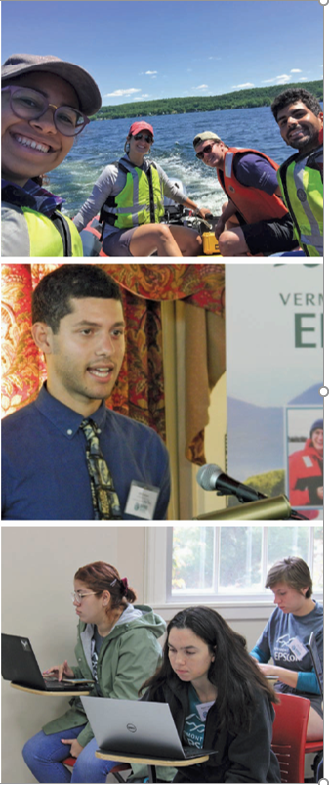

Slide 2
Application Deadline: 18 February 2020
vgn.uvm.edu/FundingOpportunities
Internship Dates: 28 May – 7 August 2020

Slide 3
www.GoEco.org

Slide 4
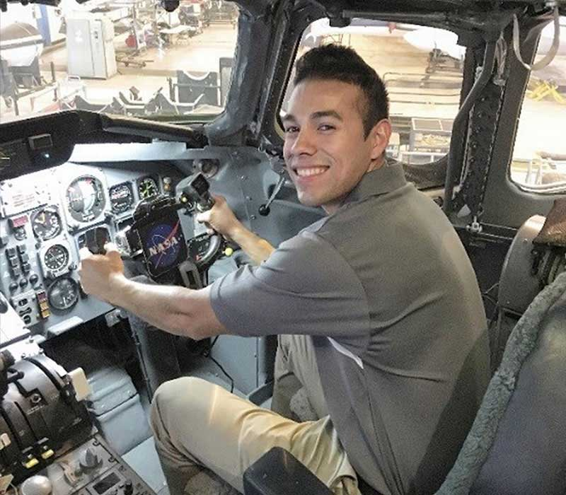
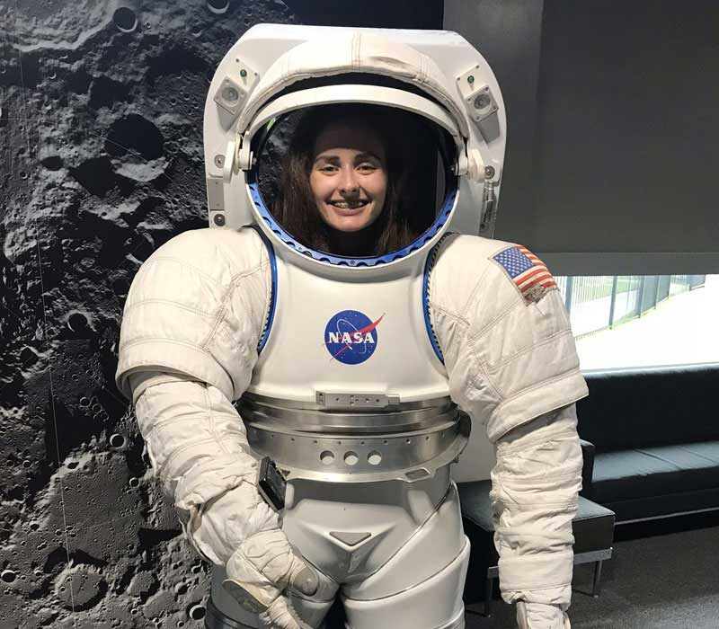
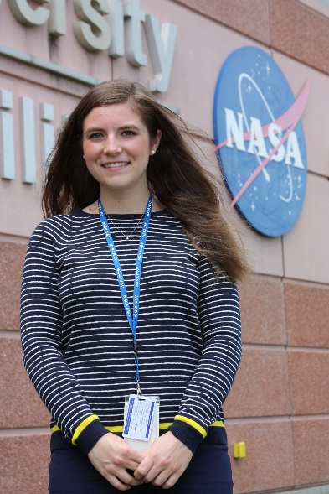
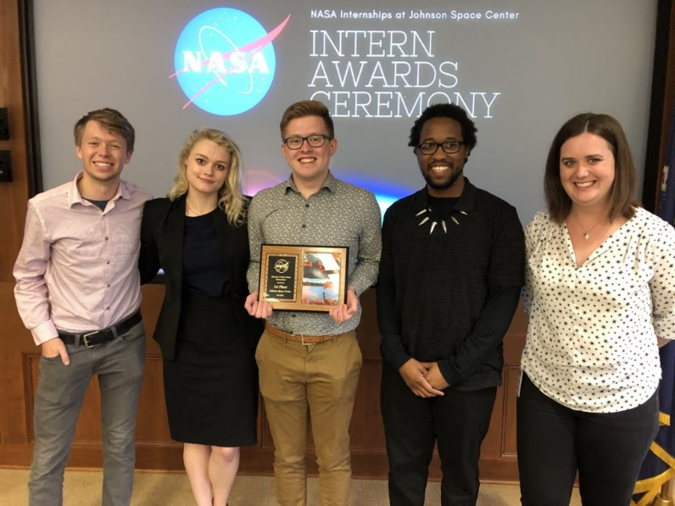
Be an intern at NASA.
https://intern.nasa.gov

